Slide 1

DESIGN OF THE TRANSBOT 1.0
INTRODUCTION TO MECHATRONICS
GROUP-5
Dajr Alfred
Ifedayo Olusanya
Sakshi Yadav
Sai Rethish

Slide 2

MOTIVATION!
The pandemic caused several changes to our way of life and has made us more cautious about the spread of disease. The transbot 1.0 is designed to:
Serve as a support to delivery networks.
Preserve life by reducing the need for human contact during a pandemic.

Slide 3
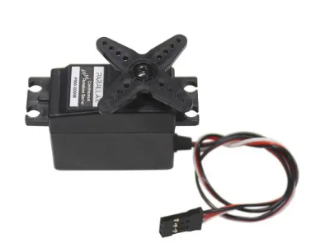
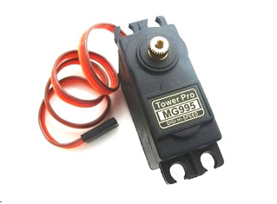
ELECTRONIC COMPONENTS
Continous Rotation Servo Motor
The transbot makes use of 2 continous rotation servo motors.
These servos collect intructions from the BS2 to determine their operation.
These servos enable the transbot move left,right,forward and backward.
180 Positional Servo Motor
The positional servo motor is located in the delivery box.
It’s used to convert rotation to translation for delivery of items
It’s connected to a connecting rod and shaft.

Slide 4
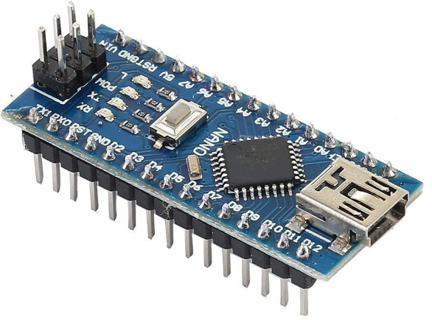
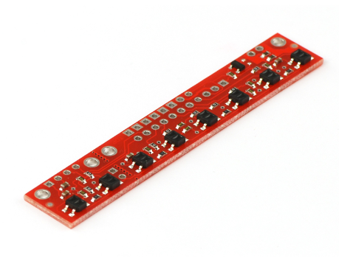
ELECTRONIC COMPONENTS
Arduino Microcontroller
Serves as an interface between the BS2 and Pulolo.
Collects readings from BS2 on when to start operation of Pulolo.
Collects Positional readings from the pulolo and sense readings to the BS2.
Pulolo Reflectance Sensor
Connected directly to the Arduino.
Helps determine the position of track during automatic operation mode.
Sends positional readings to Arduino.

Slide 5
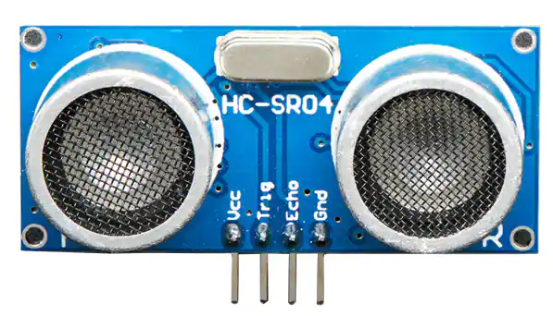
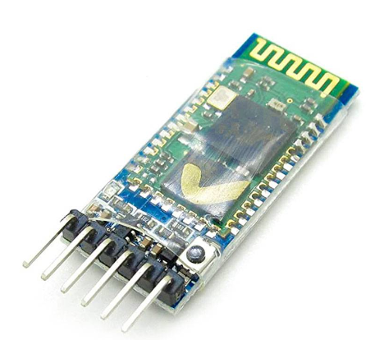
ELECTRONIC COMPONENTS
Ultrasonic Sensor
Helps transbot determine distance away from delivery location to offload package.
Helps transbot detect obstacle.
Bluetooth Module
Serves as an interface for serial communication between the Transbot_UI App and BS2.

Slide 6
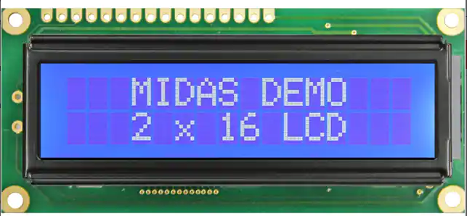
ELECTRONIC COMPONENTS
LCD Display
Serves as a user interface.
Displays information about the status of operation of the transbot.

Slide 7
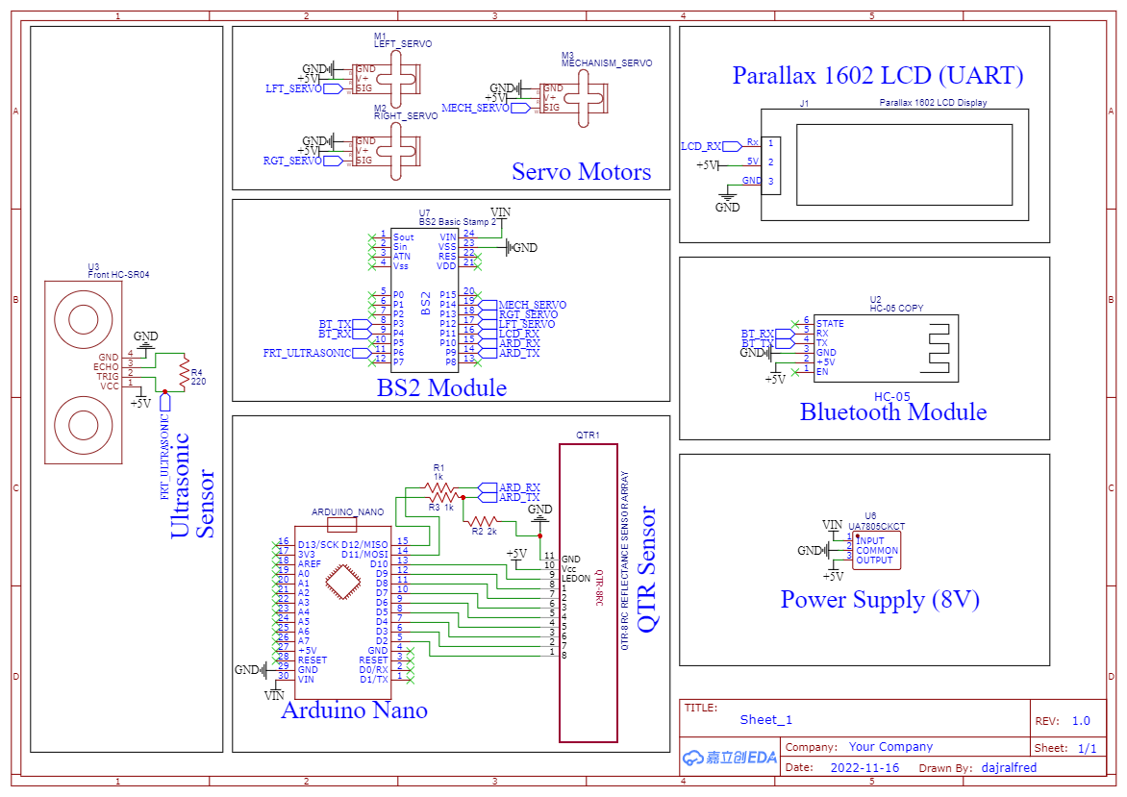
ELECTRICAL SCHEMATIC DESIGN
BS2 Schematics

Slide 8
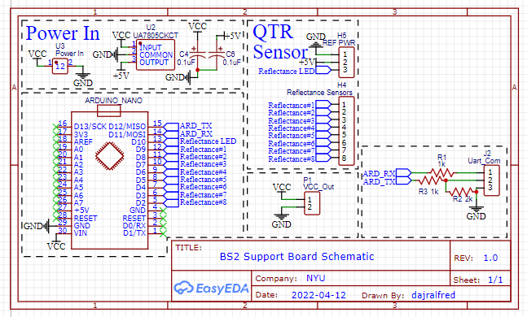
ELECTRICAL SCHEMATIC DESIGN
Arduino Schematics

Slide 9
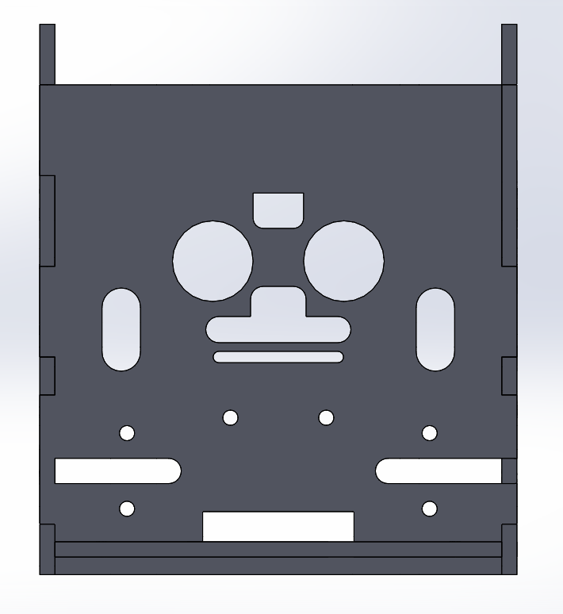
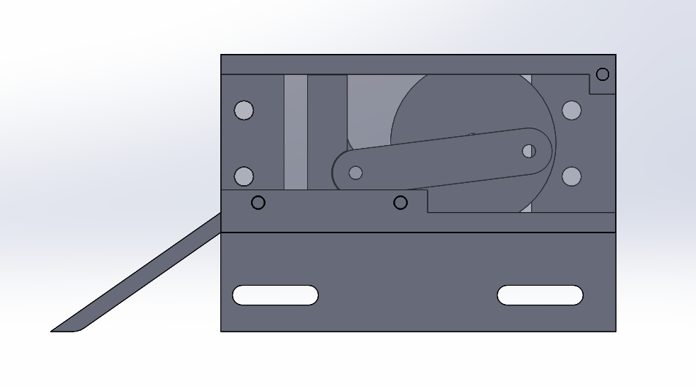
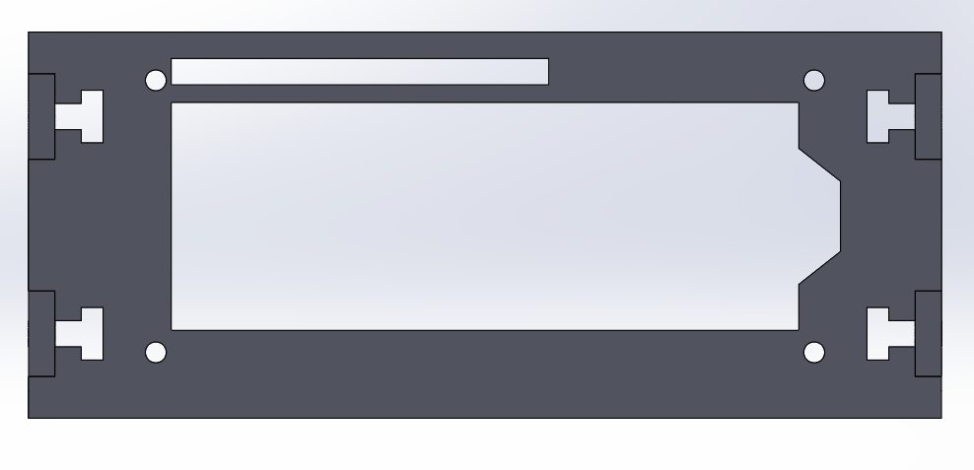
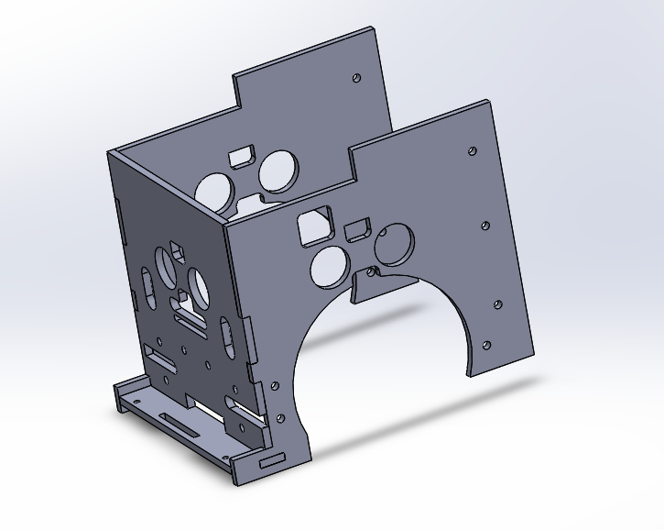
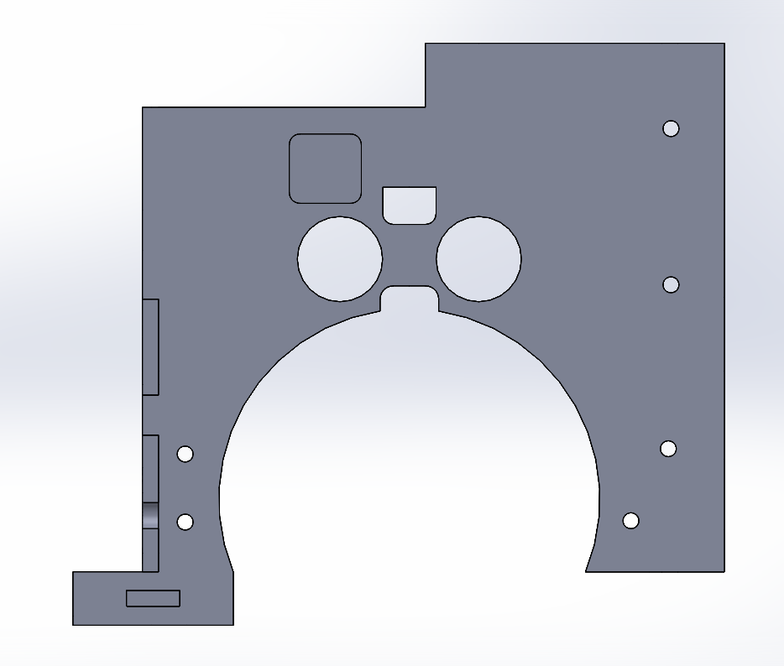
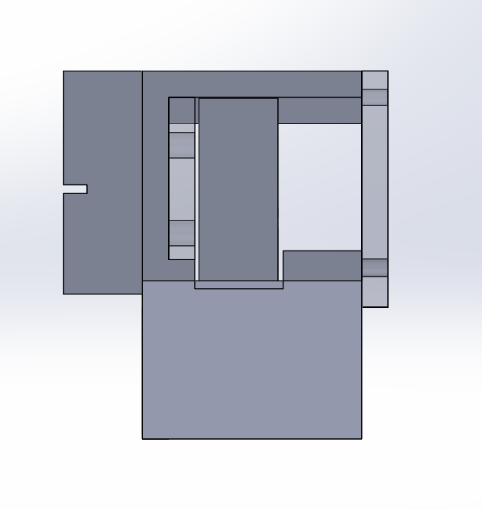
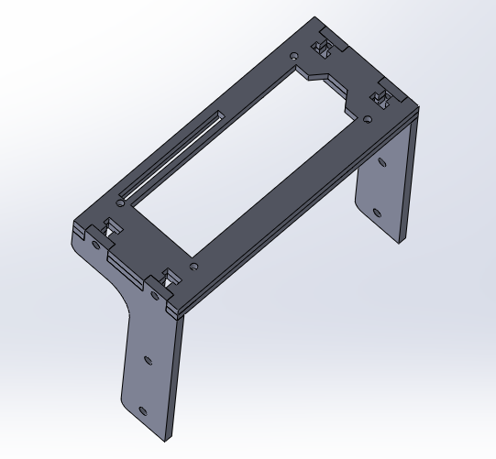
MECHANICAL COMPONENTS & DESIGN
Transbot Body
Mechanical Delivery System
LCD Case

Slide 10
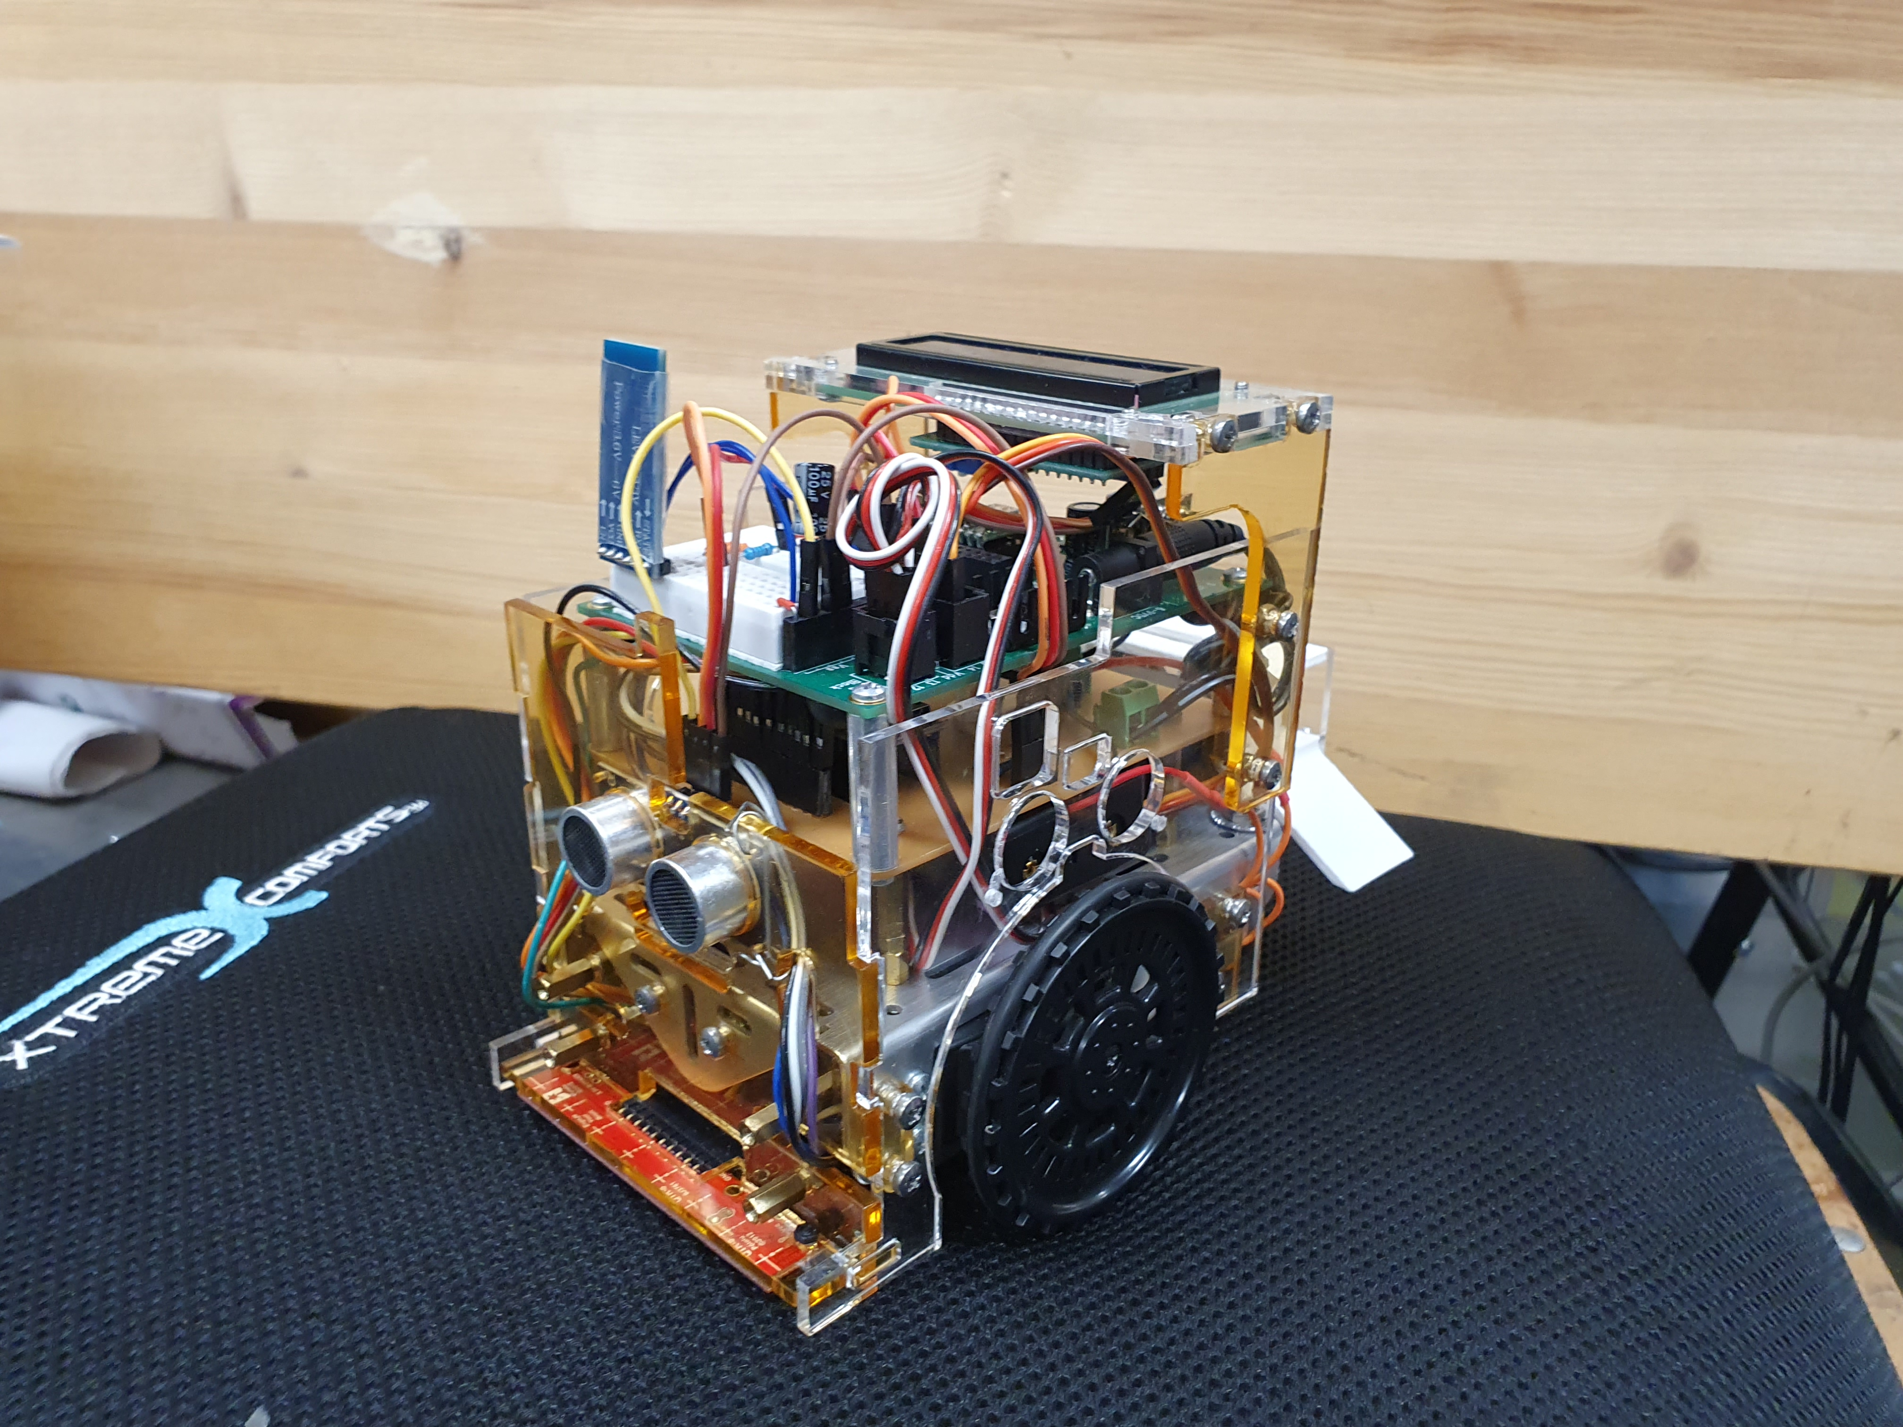
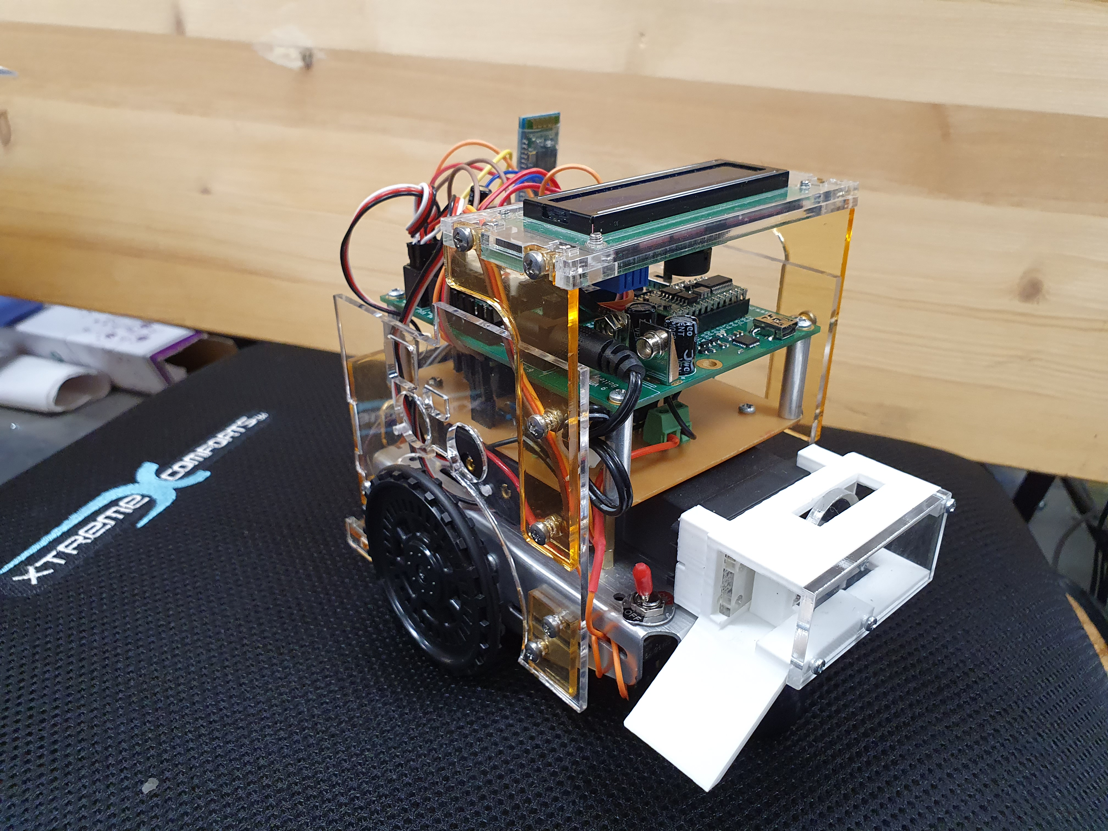
MODE OF OPERATION & ASSEMBLY
The Transbot 1.0 works in 2 mode:
RC Mode: In RC mode, the transbot is manually controlled by the operator using a mobile App.
Automatic Mode: The transbot autonomously delivers items to a specified GPS location.
Note: Transbot can shift between modes.

Slide 11
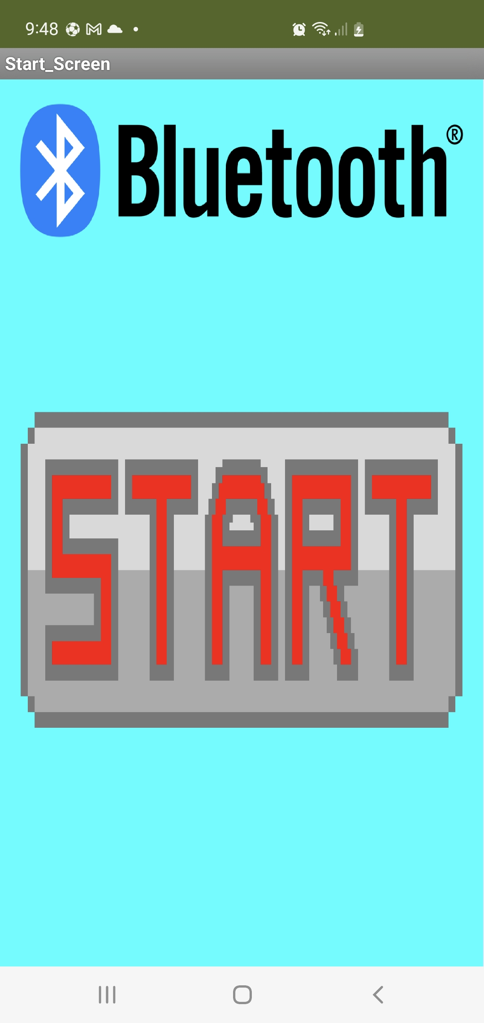
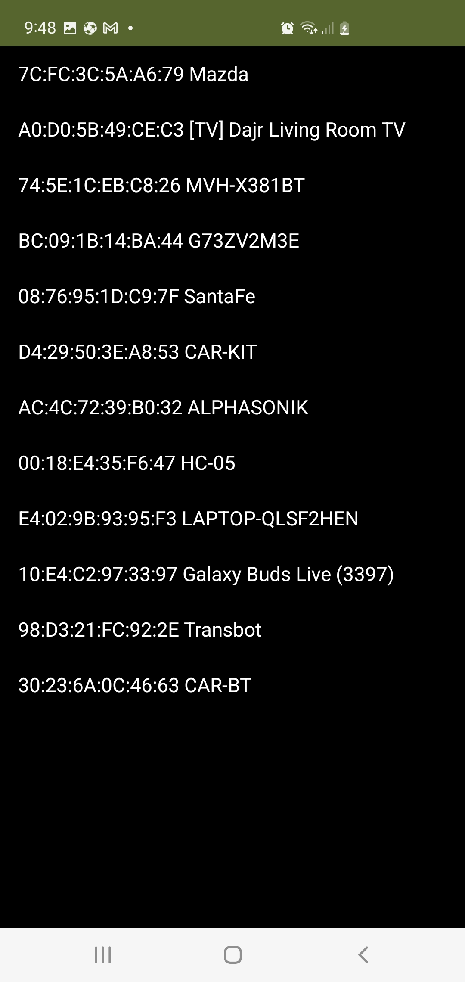
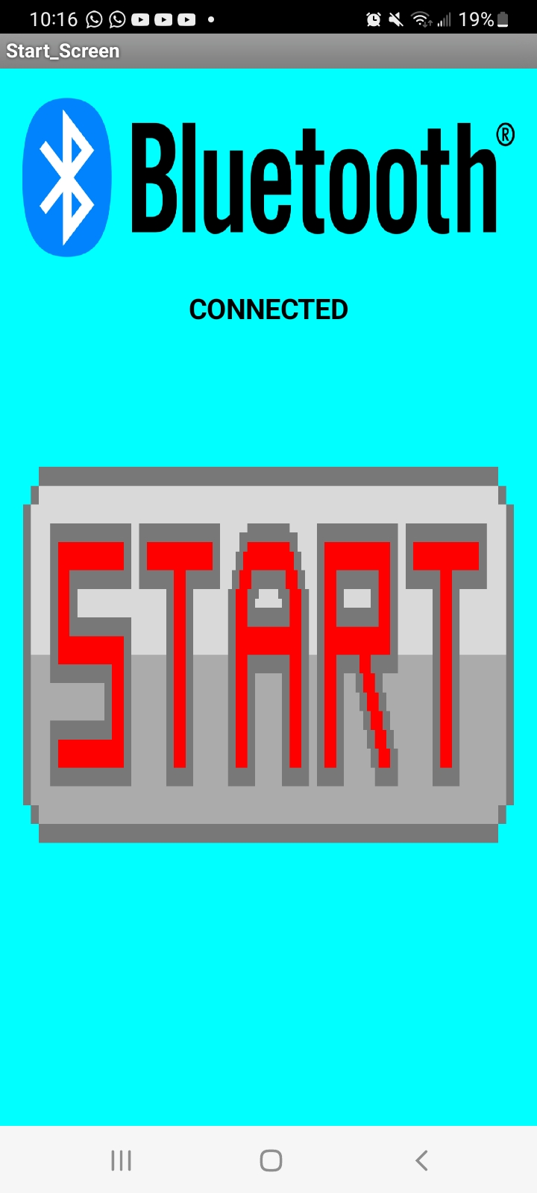
APPLICATION UI
Transbot_UI Screen 1
Connect to bluetooh Module
Bluetooth Connected

Slide 12
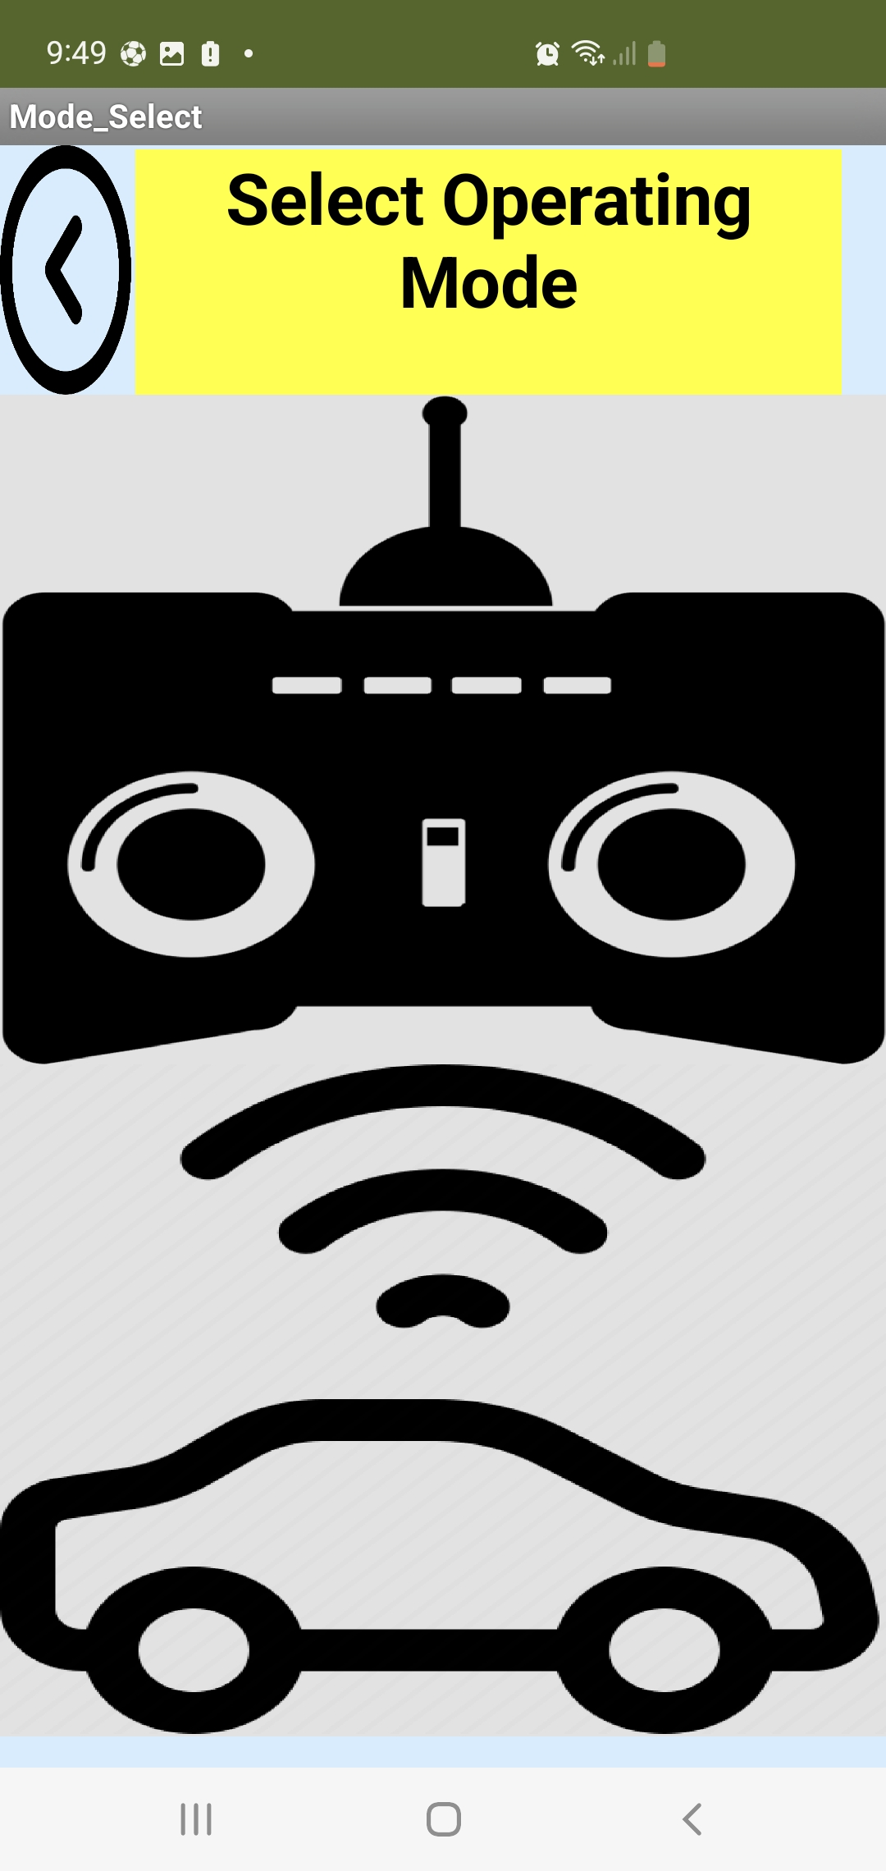
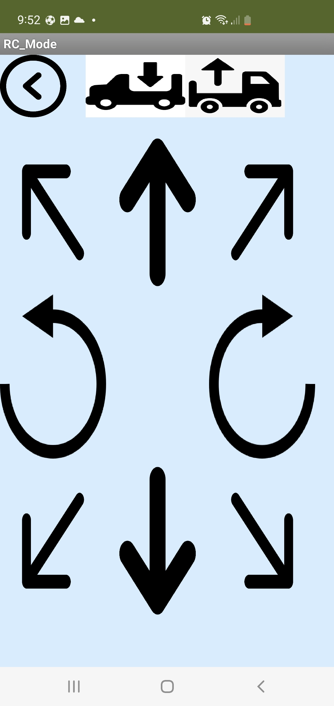
APPLICATION UI
Start Operation
Select Operating mode
RC Mode Screen

Slide 13
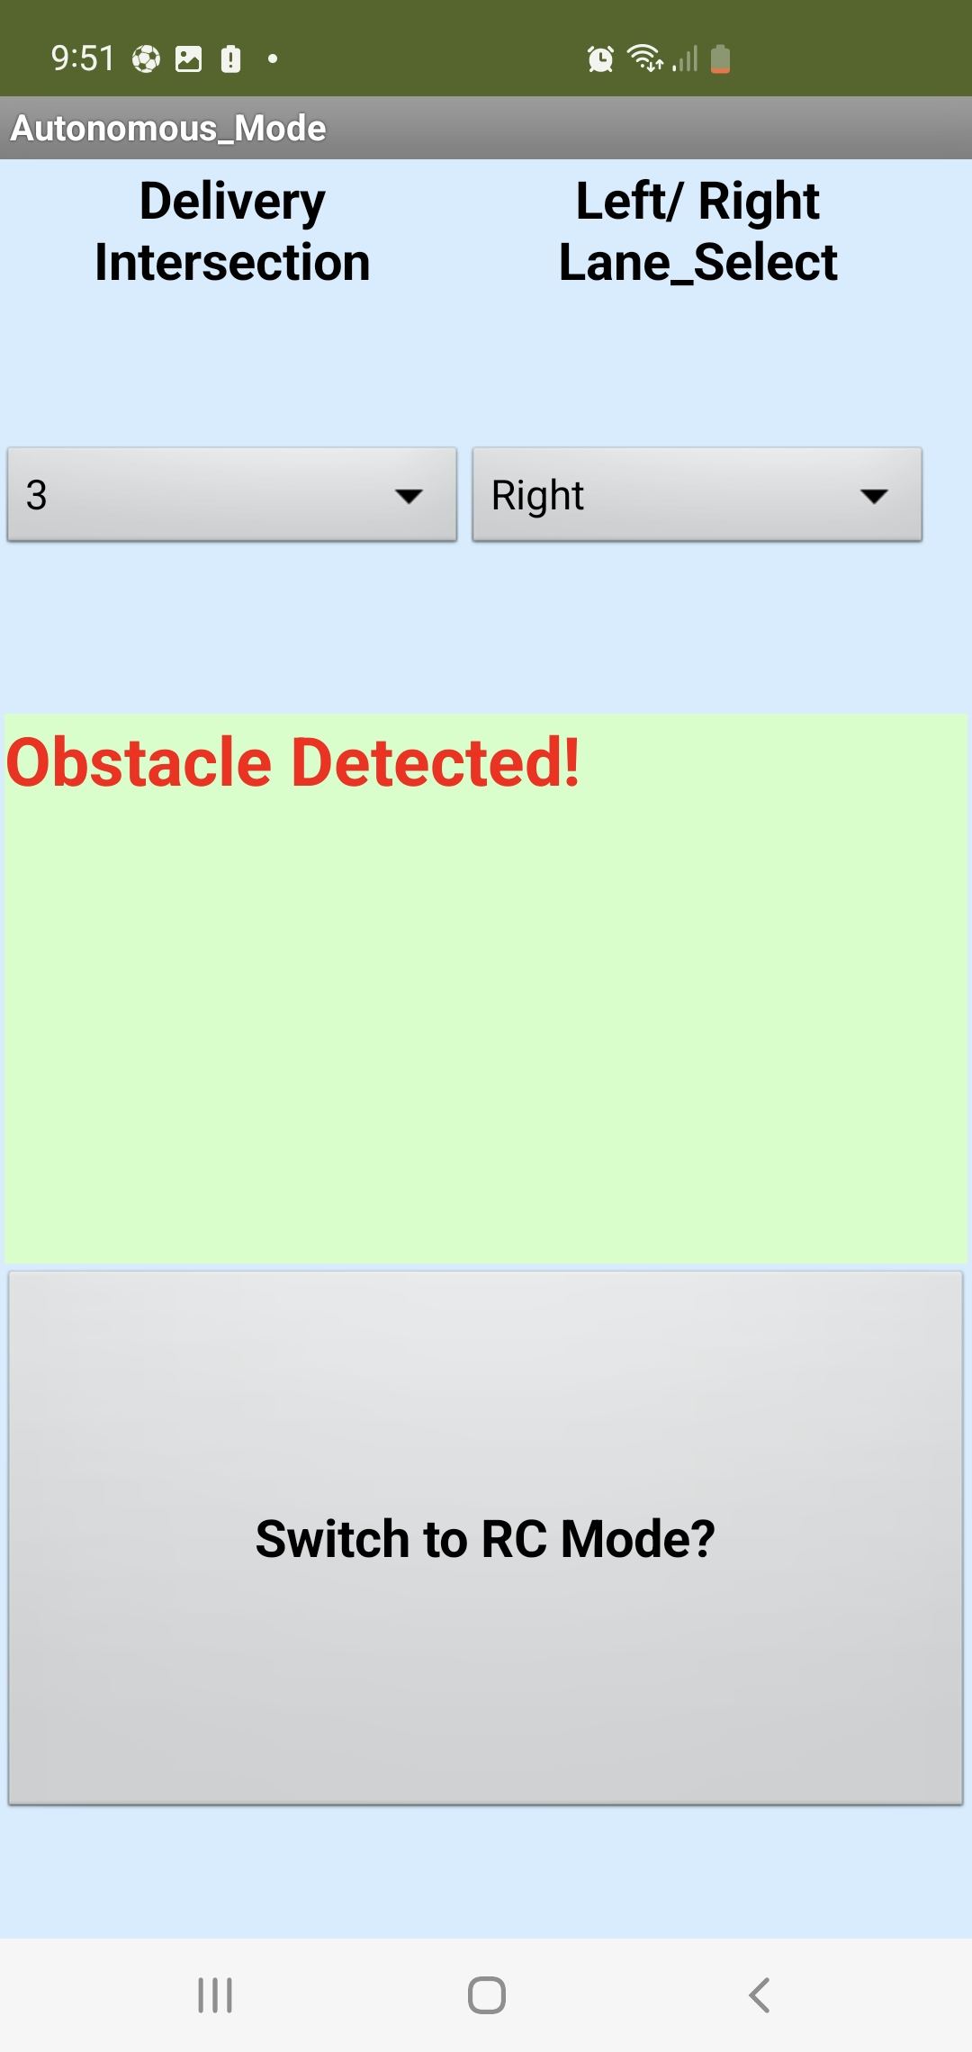
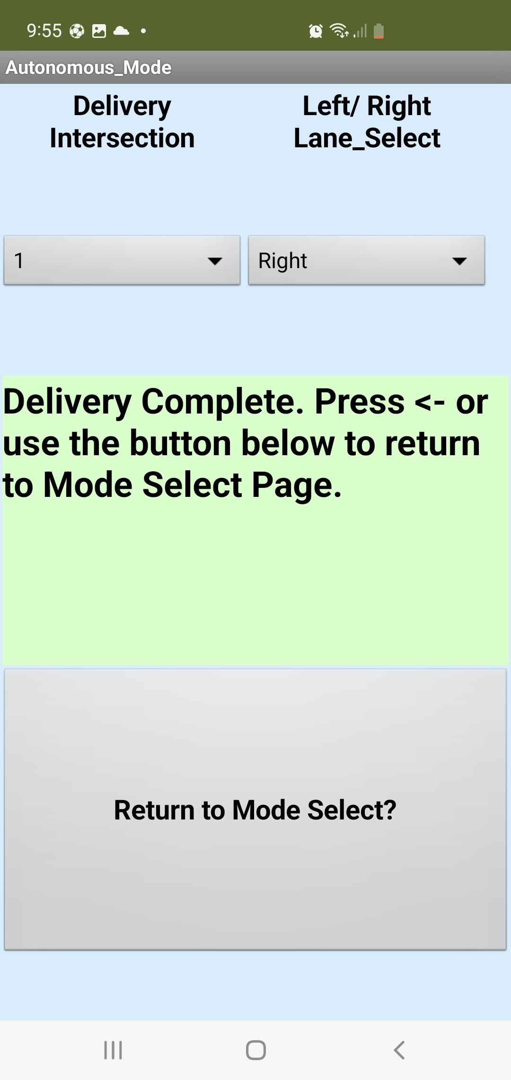
APPLICATION UI
Automatic Mode
Lorem 2
Lorem 3

Slide 14
BILL OF MATERIALS
Item | Quantity | Price
Pulolo Reflectance Sensor | 1 | $9.95
Ultrasonic Sensor | 1 | $2.00
Bluetooth Module | 1 | $8.71
LCD | 1 | $34.95
Positional Servo Motor | 1 | $7.50
Arduino | 1 | $8.00
Boe-Bot Robot Kit | 1 | $249.95
Acrylic Sheet | 1 | $15.00
PCB Blank | 1 | $1.00
Miscellaneous | 1 | $20
 | TOTAL | $357.06

Slide 15
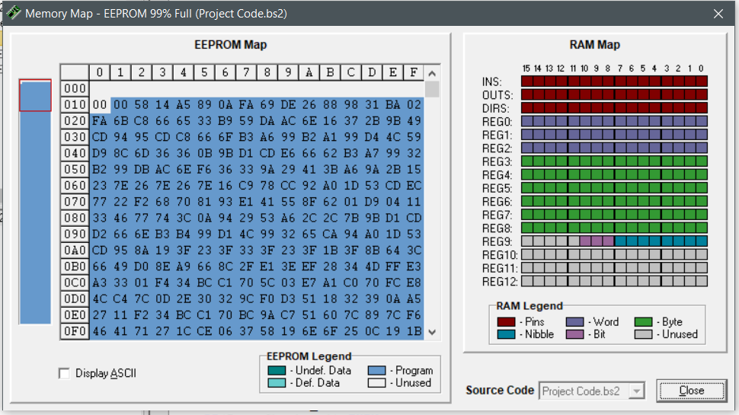
LIMITATION OF DESIGN
BS2 has just 2KB of EEPROM which makes it difficult to code complex operations.
Lack of necessary libraries on Pbasic.
The components that interface with the BS2 are quite expensive which is a limitation on mass production.
Code Usage

Slide 16
CREDITS
Presentation template by SlidesCarnival
Photograph 1 by Unsplash
Continuous Servo Motors
180 Positional Servo Motor
Arduino Nano

